Slide 1

Choice of Topic

Slide 2
Project 1
An Analysis of GCSE Examination Results in England
By
Mohammed Nawaz
Elcin Imanci
Yuk Hang Hui
Kashfi Khalid
Muse Amin
Adel Mahmud

Slide 3
Research Questions
How do gender, ethnicity and social class affect GCSE outcomes?
Is there a gender difference in the subjects that students take for their GCSEs?
Does the type of school attended affect GCSE outcomes?
Does geography affect students GCSE outcomes?
Was there a difference in GCSE outcomes between state and independent schools during COVID?
Are some subjects easier to get a Grade 9 in than others?

Slide 4
Data Source
The data was obtained from:
https://www.gov.uk/government/collections/statistics-gcses-key-stage-4
Data files
Guidance

Slide 5
Before we start ……

Slide 6
Measures of Success in Education
Attainment 8
The average measure of an individual student’s progress across their 8 best performing subjects which fall into three buckets.
Progress 8
This is a measure of students’ progress across 8 subjects. This is a value added measure whereby students’ results are compared to students who had the same prior attainment score at KS2. It uses the same buckets as Attainment 8.

Slide 7
Buckets for Subjects
Bucket 1: English and Maths
The score for Maths and English will be double weighted.
Bucket 2: Three highest Ebacc subjects, which are as follows:
• Separate Sciences
• Core & Additional Sciences
• Computer Science
• History
• Geography
• Languages
Bucket 3: Three ‘other’ subjects in which students have received their highest grades.

Slide 8
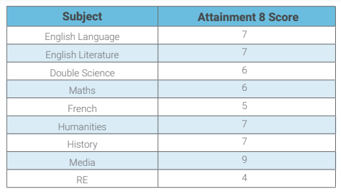
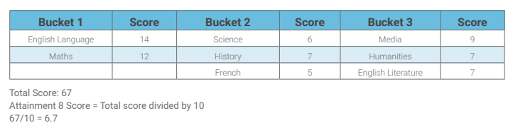
An Example
Amy achieved the following grades in her examinations:
GCSEs are graded from 1 to 9

Slide 9
Calculating a student’s Progress 8 score
Amy’s Attainment 8 score = 67
Amy’s estimated Attainment 8 score = 59.95
Progress 8 score = (67 – 59.95) / 10 = 0.71

Slide 10
Q1 Analysis
What effect do gender, ethnicity and social class have on GCSE outcomes?

Slide 11
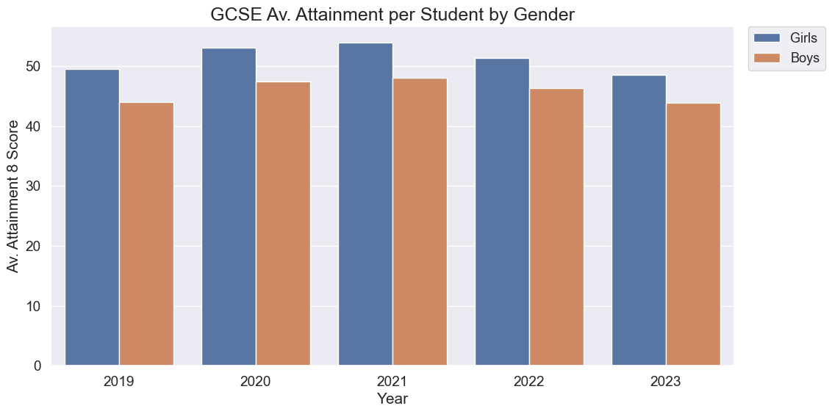
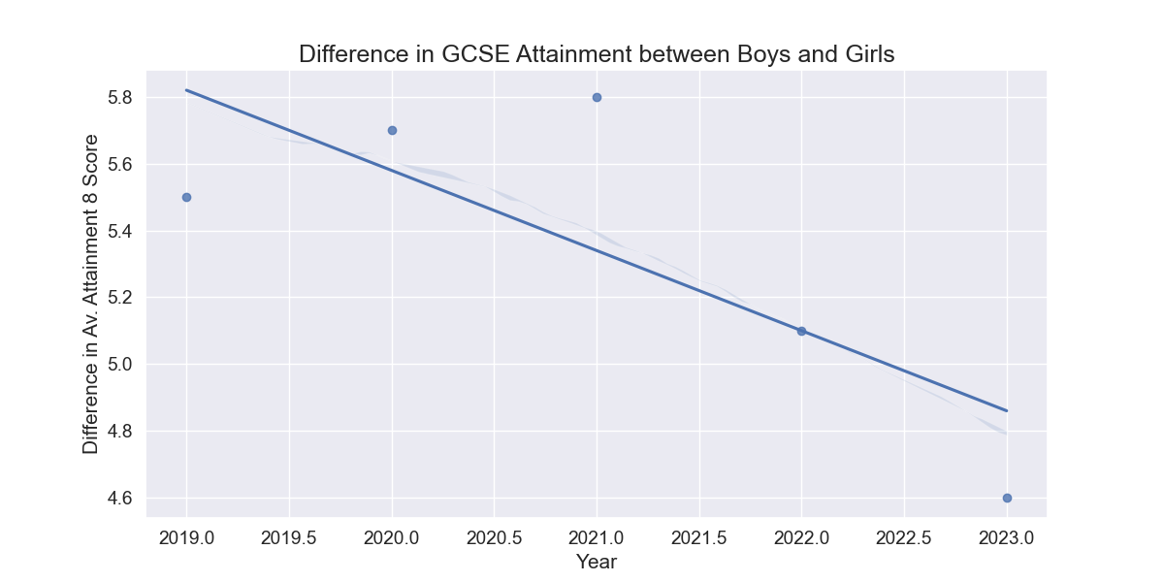
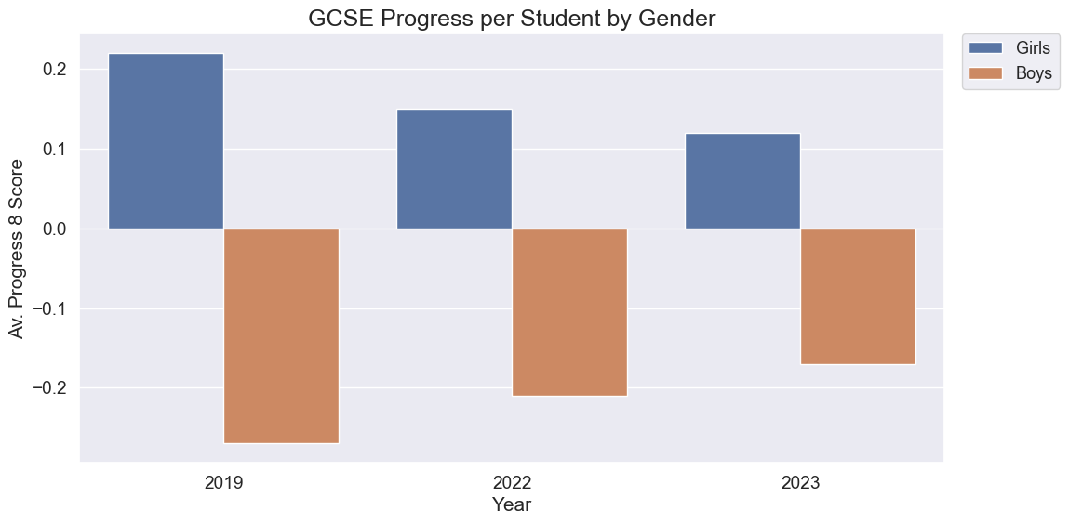
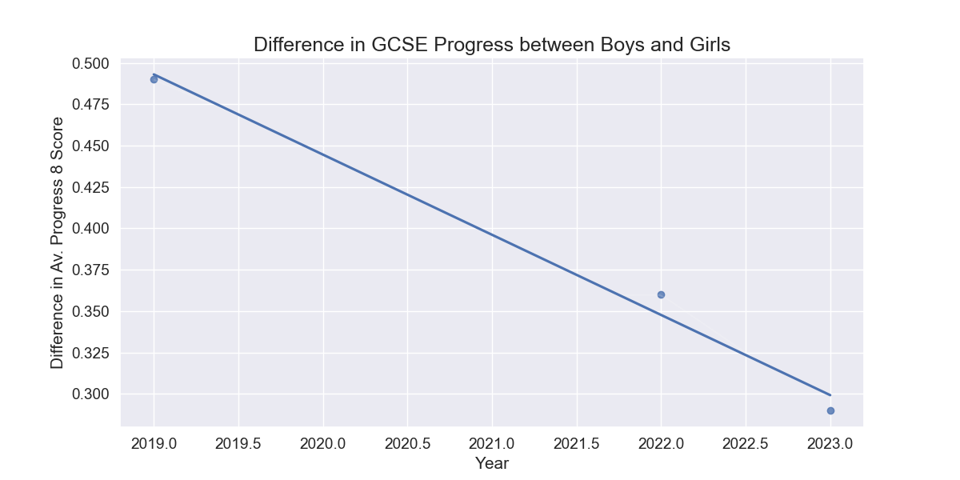
Gender Analysis

Slide 12
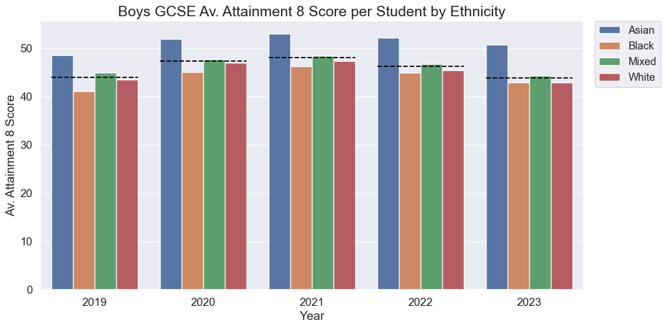
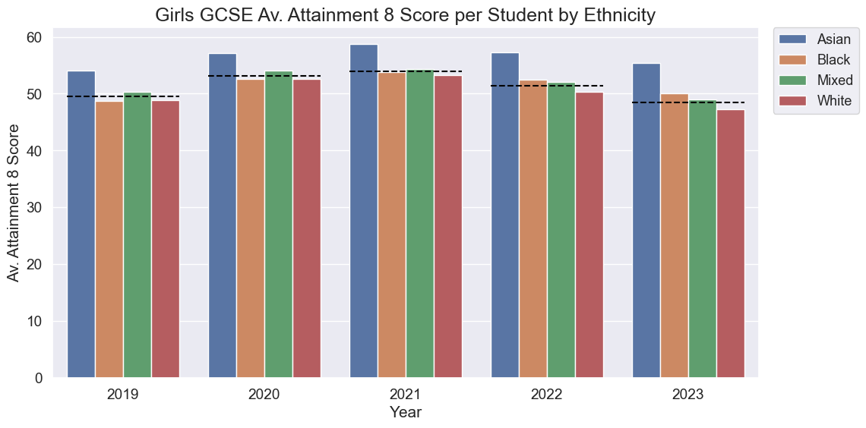
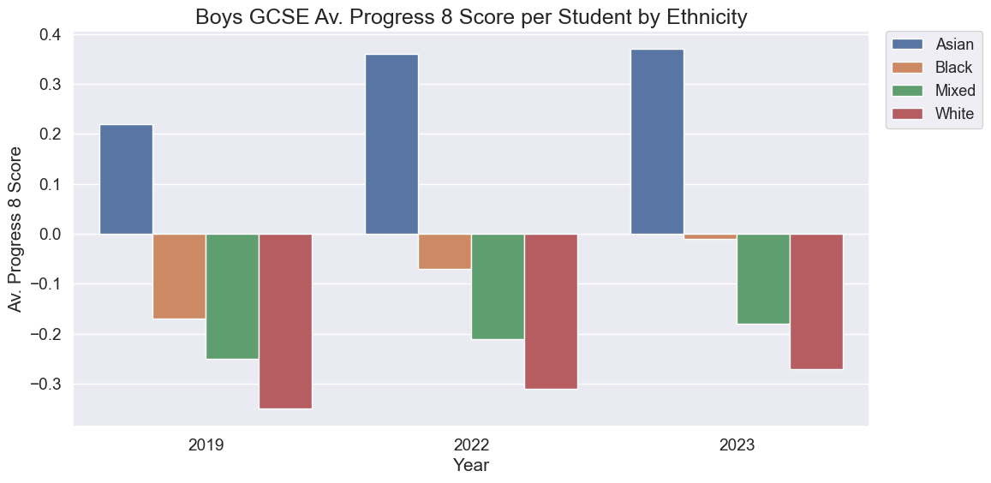
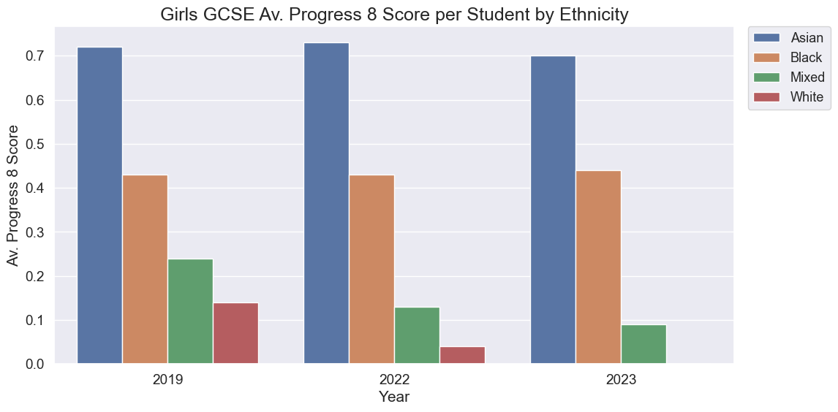
Ethnicity Analysis

Slide 13
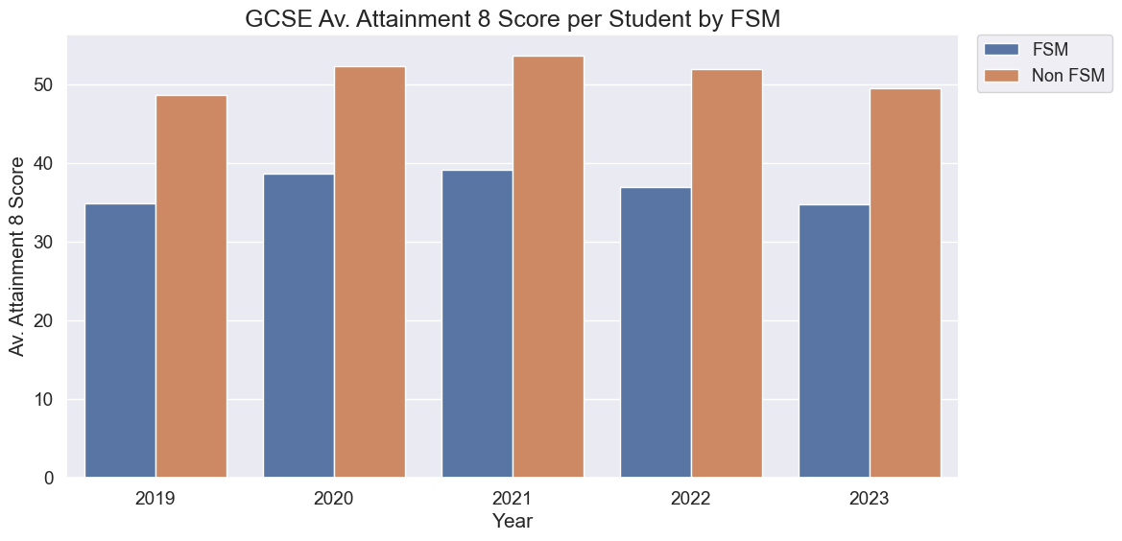
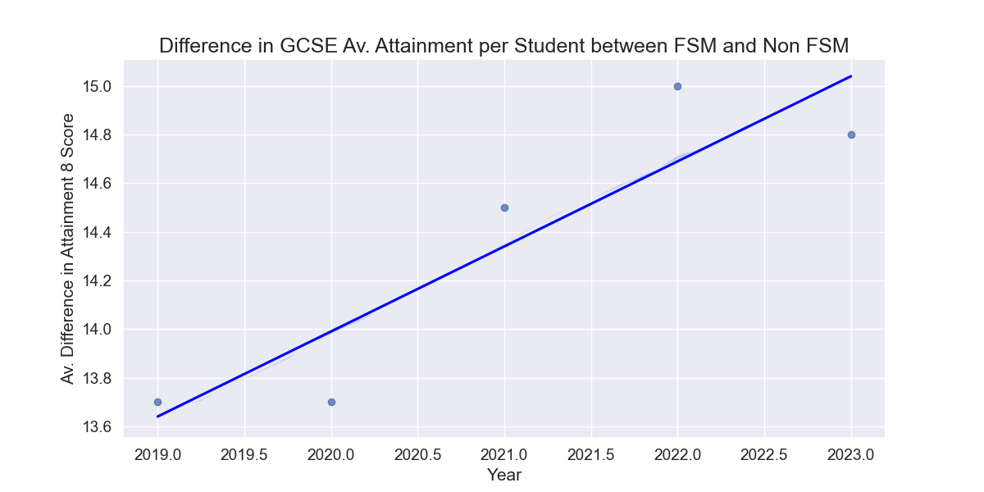
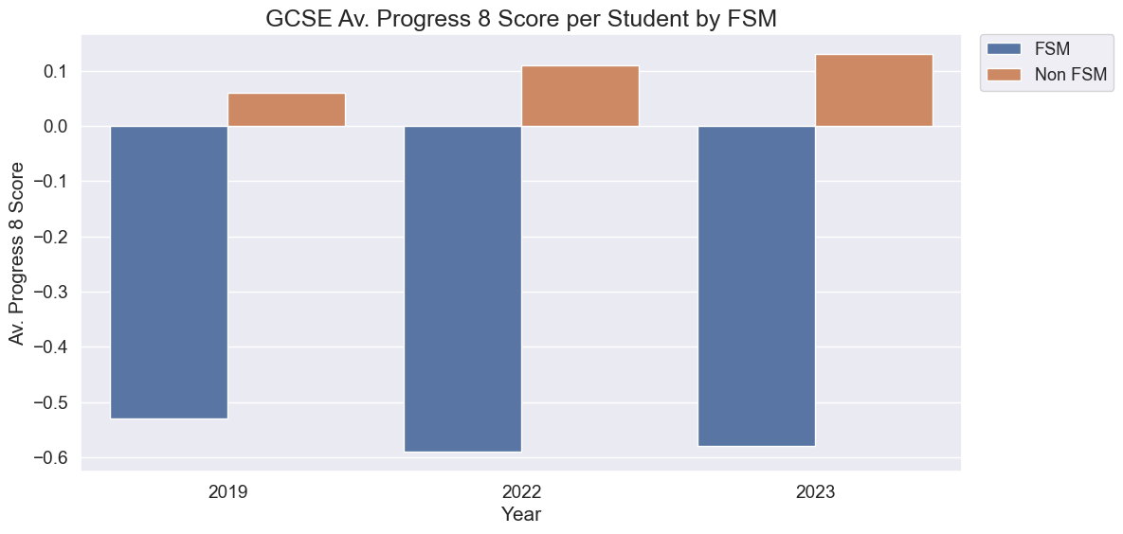
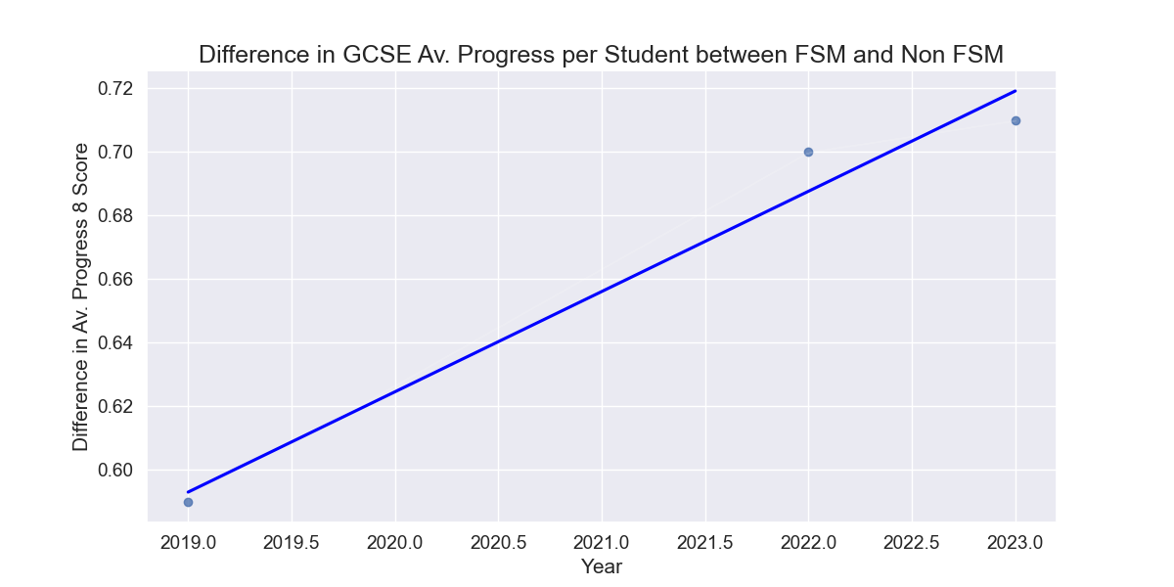
Social Class Analysis

Slide 14
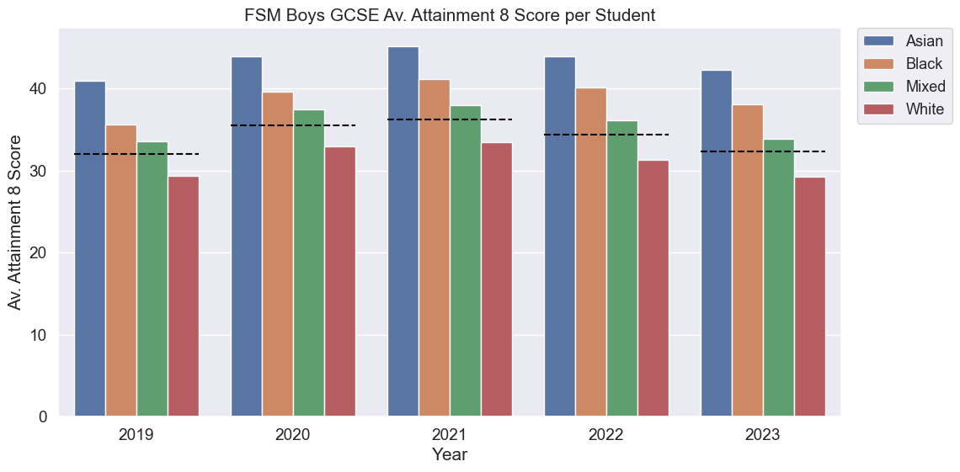
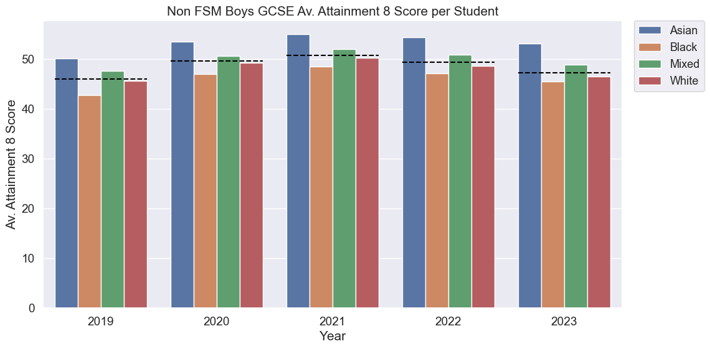
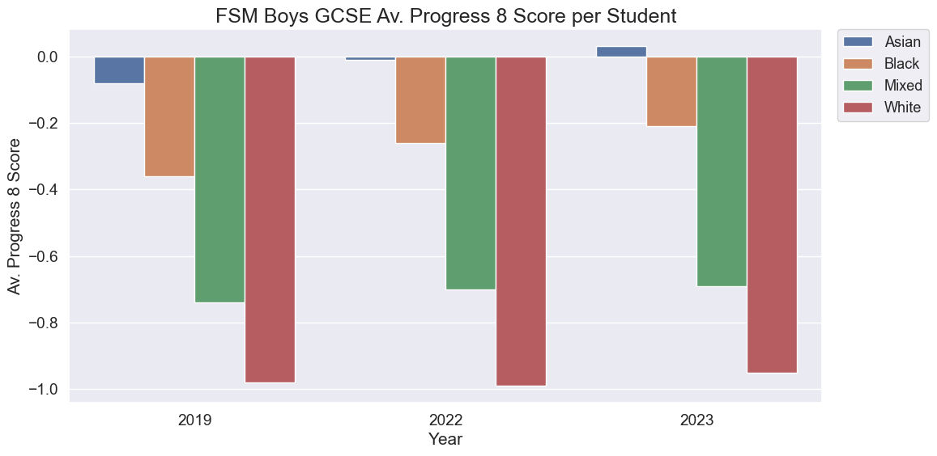
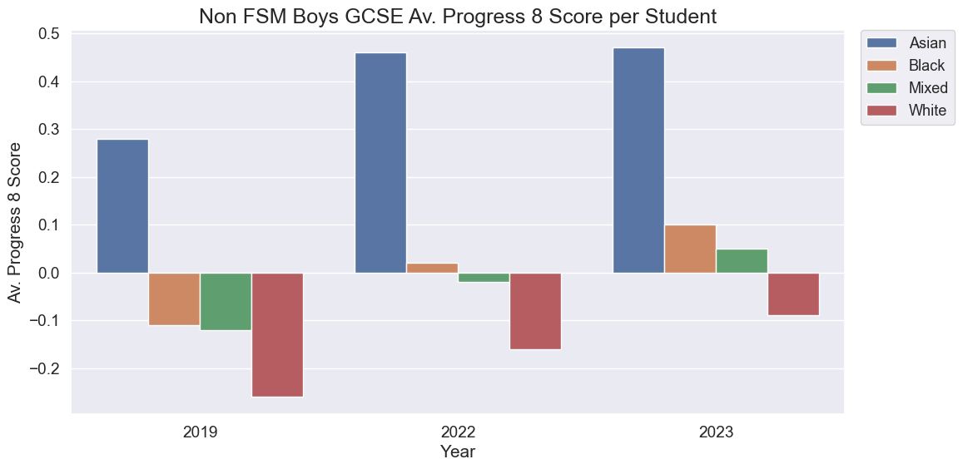
Social Class and Ethnicity Analysis

Slide 15
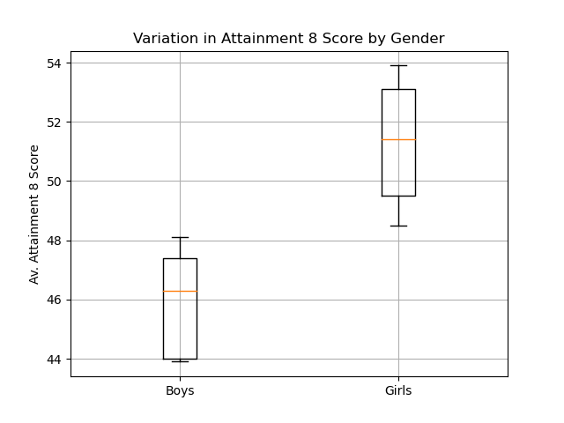
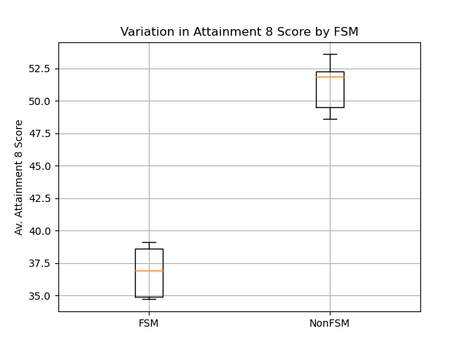
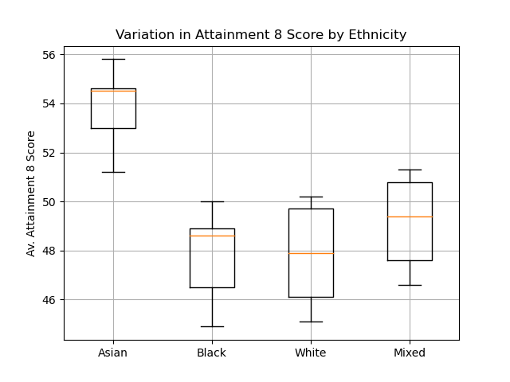
Box Plots

Slide 16
Annova Test on Gender, Ethnicity and Class
 | p-value
Gender | 0.004
Ethnicity | 0.0006
Free school meals | 4.0 x 10⁶

Slide 17
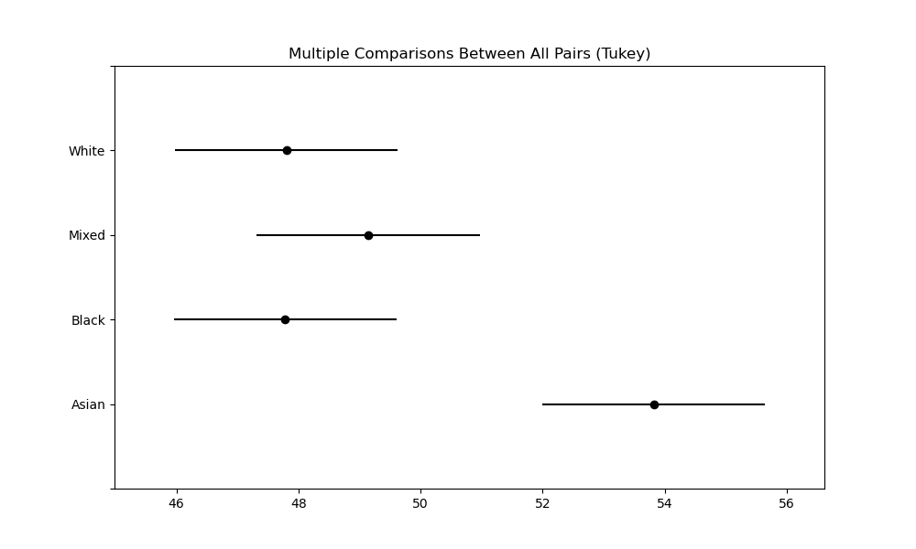
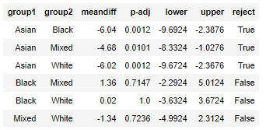
Tukey Test on Gender, Ethnicity and Class

Slide 18
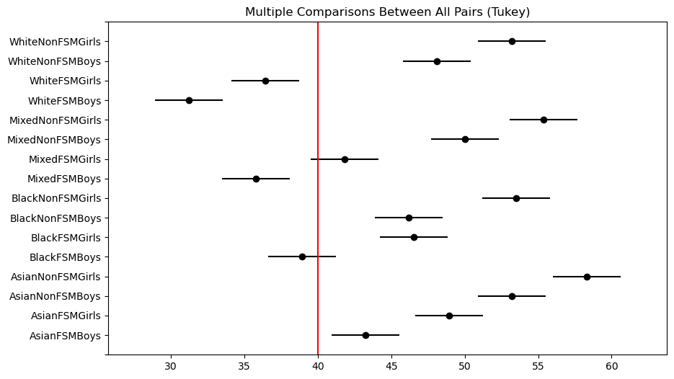
Tukey Test on All Combinations
Link

Slide 19
Q1. Summary
Gender, ethnicity and social class all have an effect on GCSE outcomes but the largest effect is due to social class.

Slide 20
